Slide 1
Differentiable Programming for Data-driven Modeling, Optimization, and Control
National Academy of Engineering
The Grainger Foundation Frontiers of Engineering 2024 Symposium
National Academies Beckman Center, Irvine, California
Ján Drgoňa

Slide 2
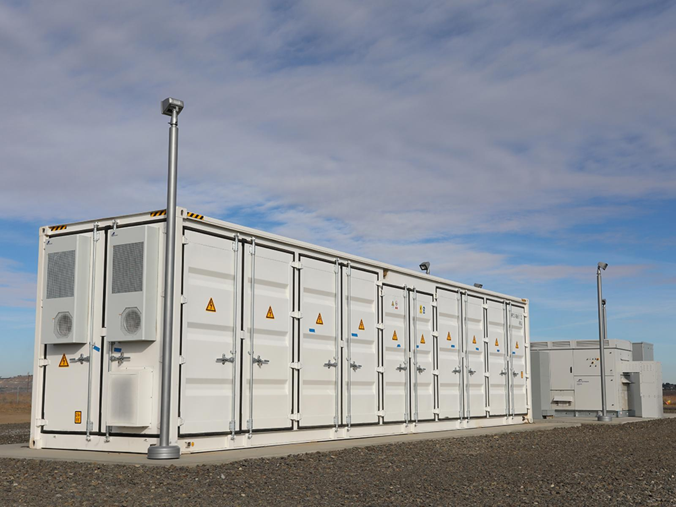



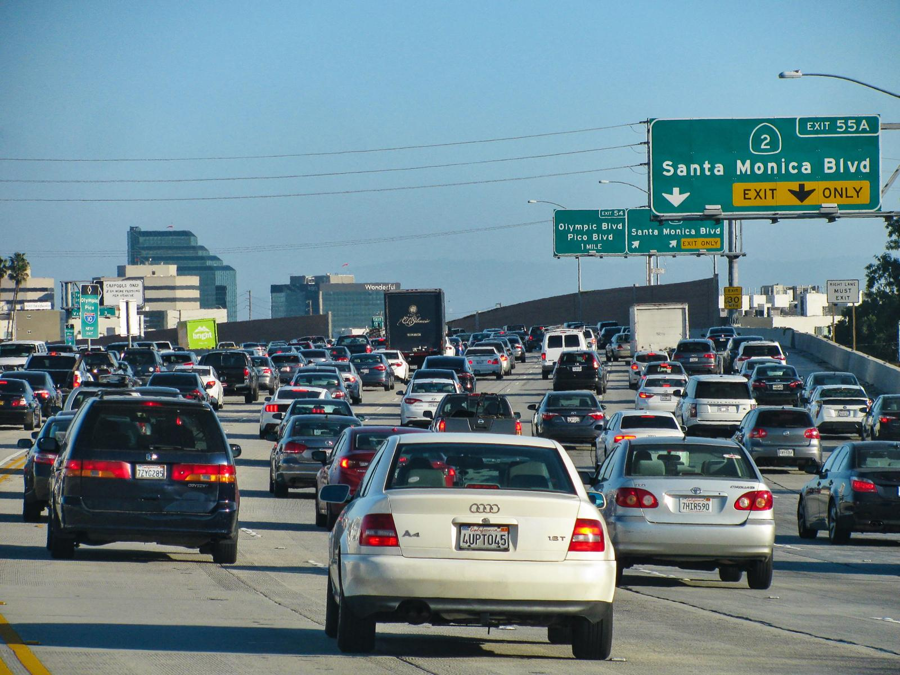
Optimizing Complex Energy Systems is Hard
Digital-twin simulations are crucial for optimal decision-making in complex energy systems
Need: Improve computational efficiency and scalability of digital twins
Challenges:
Modeling and simulation of complex systems is hard
Optimal control and closed-loop decision-making for complex systems is hard-er
Scientific computing and machine learning tools are fragmented and not easily composable

Slide 3
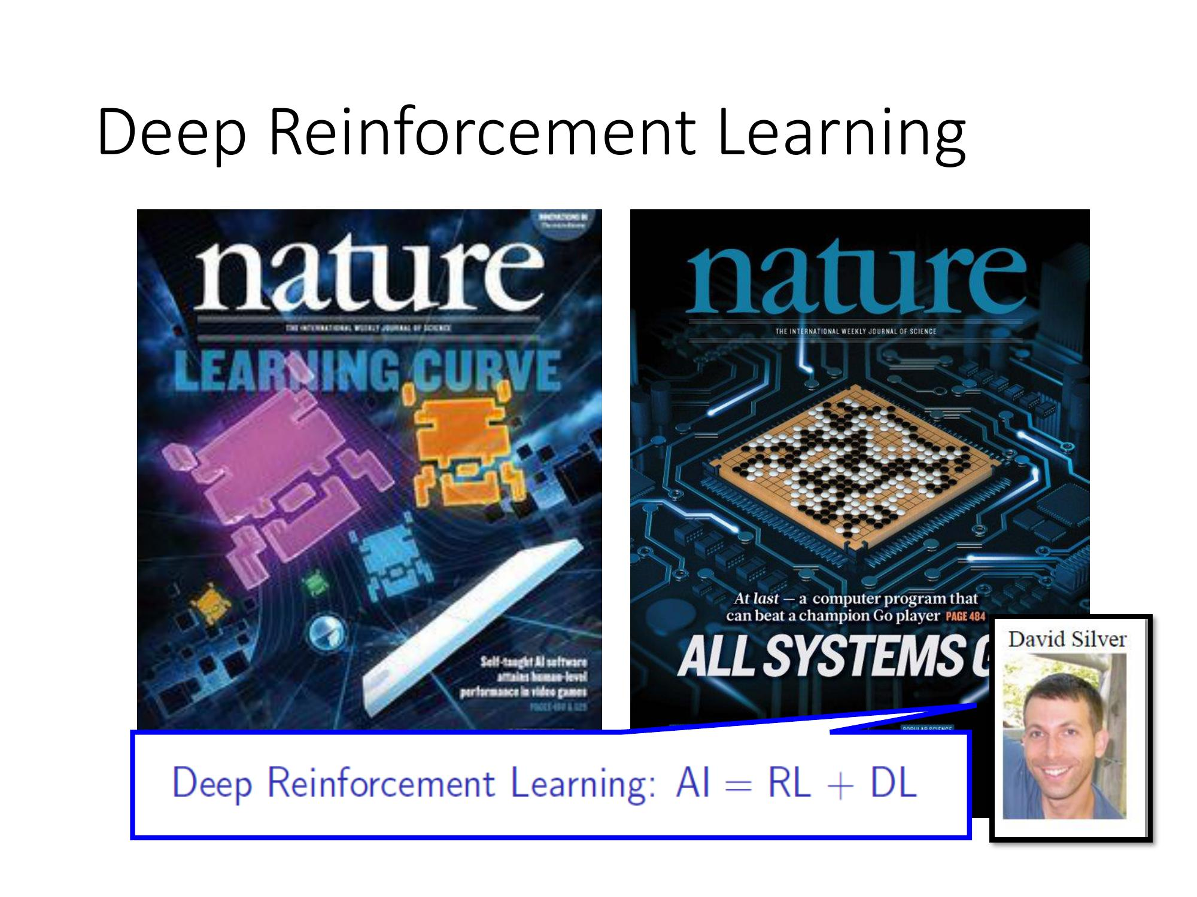

Existing Decision-Making Approaches
Model-based Optimal Control
Learning-based Optimal Control
More domain knowledge
Less domain knowledge
Drgona J., et al. "All You Need to Know About Model Predictive Control for Buildings." Annual Reviews in Control, September 29, 2020
G. Dulac-Arnold, D. J. Mankowitz, and T. Hester, “Challenges of real-world reinforcement learning,”, 2019.

Slide 4
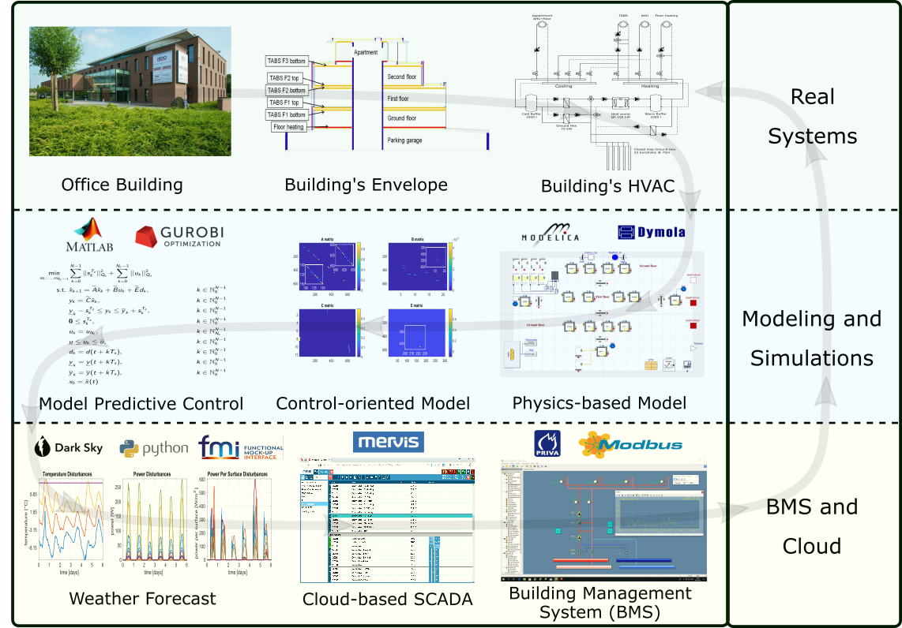
Example: Model-based Optimal Control of Building Energy Systems
Motivation
Buildings today contribute to approximately 40% of the global energy use.
Existing control solutions governing building energy systems are very inefficient.
Drgona J., et al., Cloud-based implementation of white-box model predictive control for a GEOTABS office building: a field test demonstration. Journal of Process Control, 2020.

Slide 5
Example: Model-based Optimal Control of Building Energy Systems
Upside
Heat pump energy savings up to 53%.
Improvement of thermal comfort up to 37%.
Drgona J., et al., Cloud-based implementation of white-box model predictive control for a GEOTABS office building: a field test demonstration. Journal of Process Control, 2020.

Slide 6
Example: Model-based Optimal Control of Building Energy Systems
Upside
Heat pump energy savings up to 53%.
Improvement of thermal comfort up to 37%.
Downside
Project duration: 1 year.
Expertise required: 6 staff with advanced engineering degree.
Drgona J., et al., Cloud-based implementation of white-box model predictive control for a GEOTABS office building: a field test demonstration. Journal of Process Control, 2020.

Slide 7
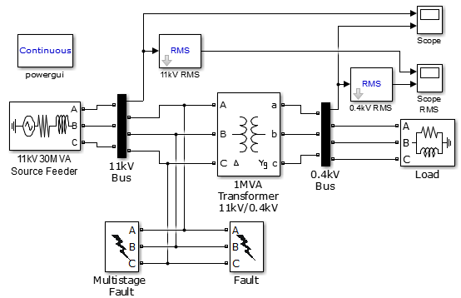
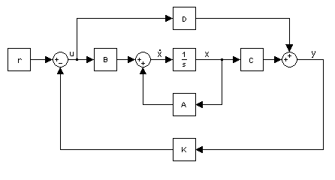

Challenge 1: Heterogenous Modeling Methods
White-box models
Gray-box models
Black-box models
Physics-based
Data-driven
More domain knowledge
Less domain knowledge

Slide 8

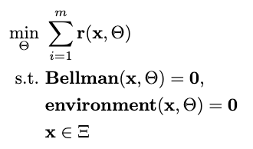

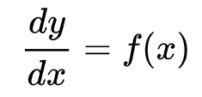

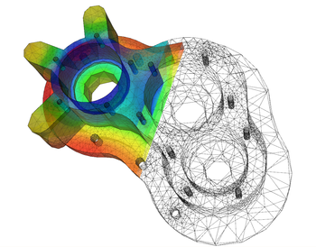
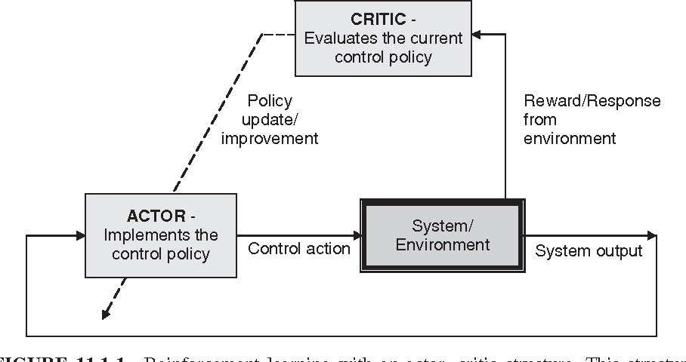

Challenge 2: Heterogenous Solution Methods
Constrained Optimization
Differential Equations
Supervised Learning
Reinforcement Learning
Requires prior knowledge of objective function and constraints
Requires prior knowledge of the physics to be modeled
Requires large labeled datasets
Requires environment model to sample
More domain knowledge
Less domain knowledge

Slide 9
















Challenge 3: Heterogenous Solution Tools
Constrained Optimization
Differential Equations
Supervised Learning
Reinforcement Learning
More domain knowledge
Less domain knowledge

Slide 10
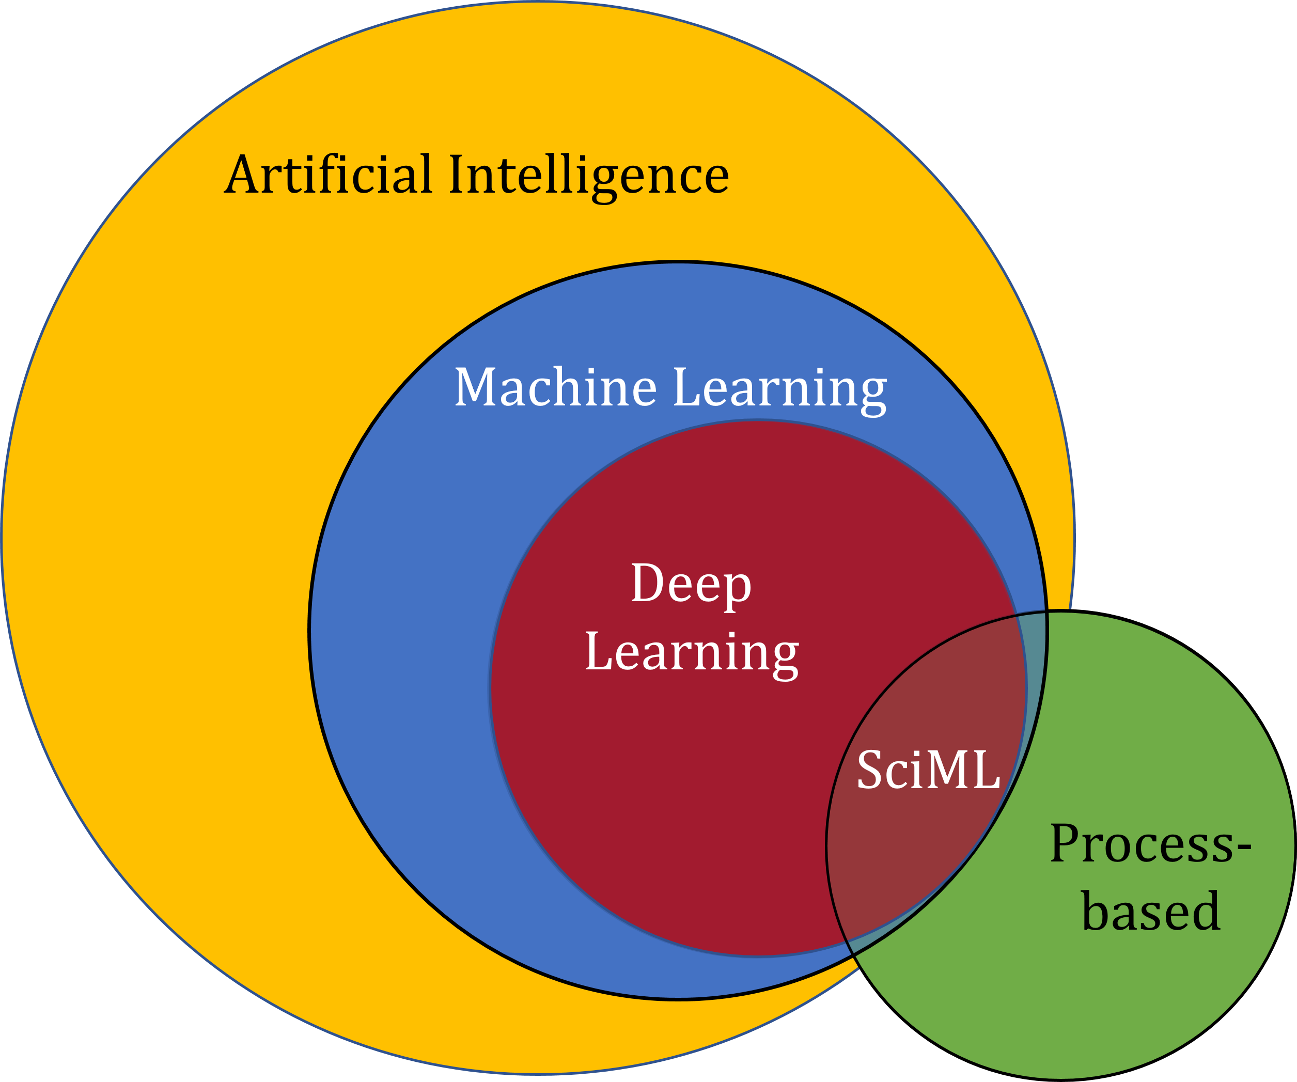
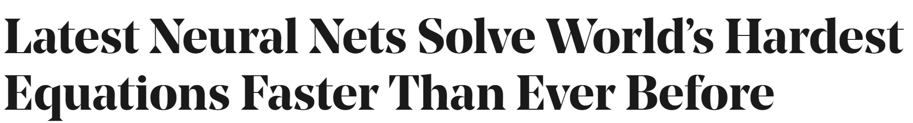

Scientific Machine Learning (SciML)
What?
SciML or Physics-Informed Machine Learning (PIML) systematically integrates ML with models and algorithms developed in traditional engineering domains
Why?
Scientific applications are governed by fundamental principles and physical constraints
Purely data-driven “black box” ML methods cannot satisfy underlying physics
How?
Leverage automatic differentiation to enable learning for modeling, optimization, and control
Image source: https://sciml.wur.nl/reviews/sciml/sciml.html

Slide 11
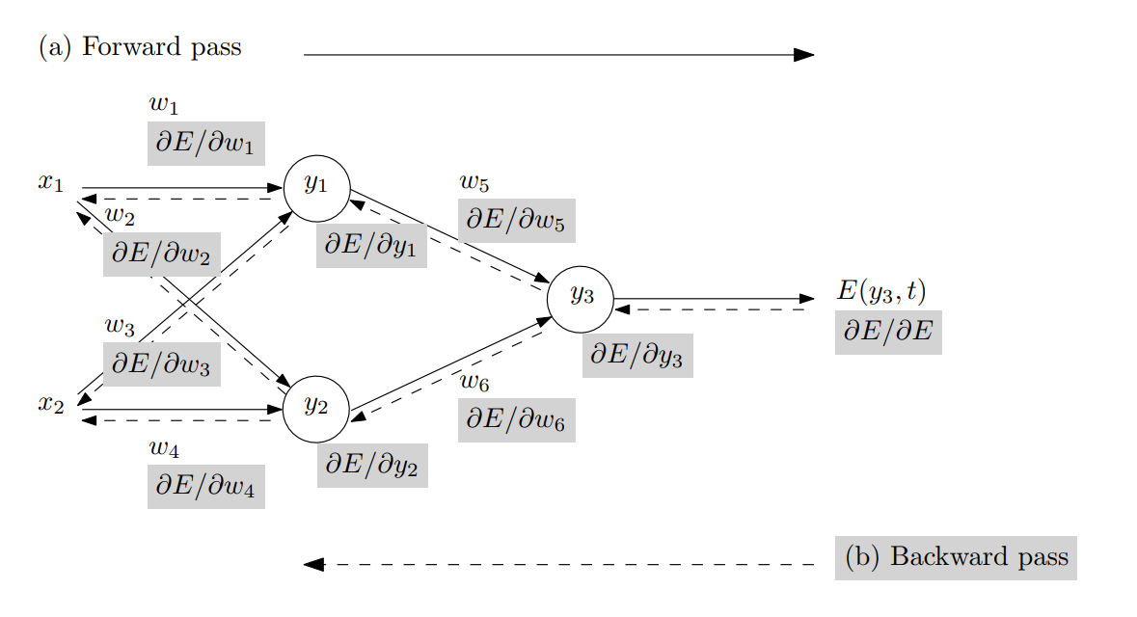
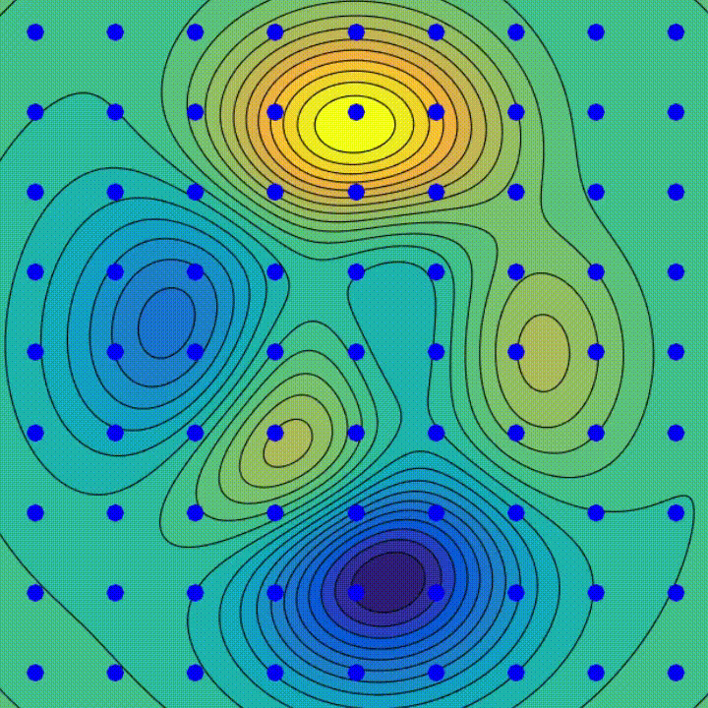
Automatic Differentiation in Machine Learning
Forward and Backward propagation
through computational graph
Gradient descent
algorithm
Animation source: wikipedia
Baydin, Atilim Gunes et al. Automatic differentiation in machine learning: a survey. Journal of Machine Learning Research, 2015

Slide 12
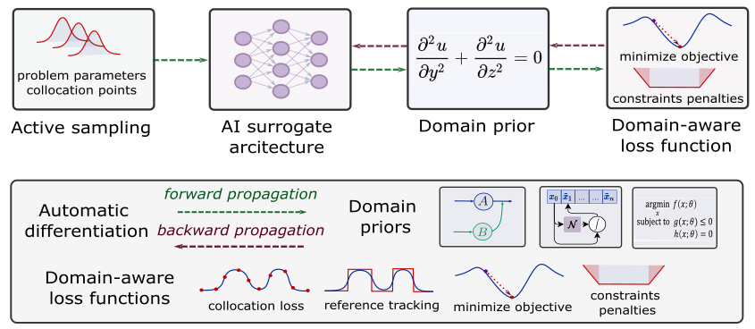
Components of Scientific Machine Learning
Karniadakis, G.E., Kevrekidis, I.G., Lu, L. et al. Physics-informed machine learning. Nat Rev Phys 3, 2021.
Thiyagalingam, J., Shankar, M., Fox, G. et al. Scientific machine learning benchmarks. Nature Reviews Physics 4, 413–420, 2022.
Nghiem T., Drgona J., et al. Physics-Informed Machine Learning for Modeling and Control of Dynamical Systems, ACC, 2023.

Slide 13

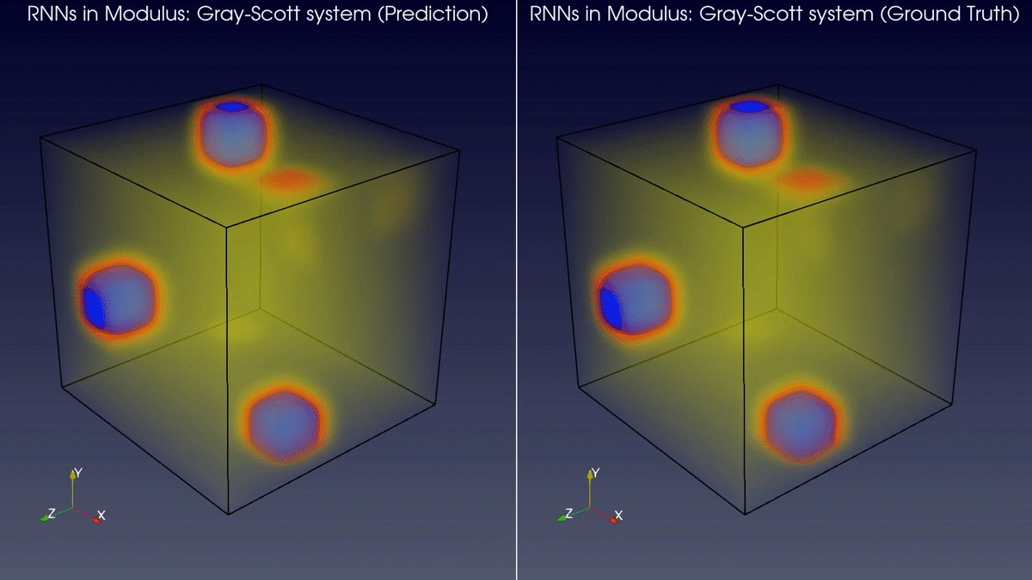
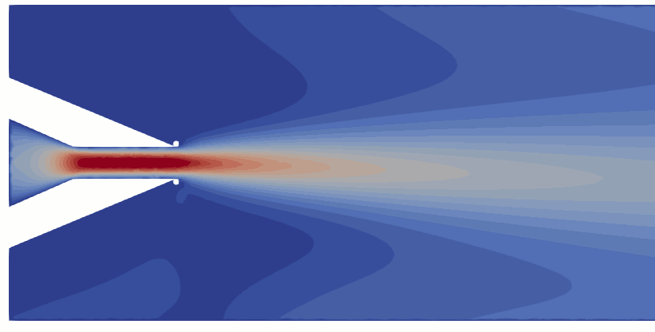
Learning to Solve Differential Equations with Physics-Informed Neural Networks (PINNs)
Training neural networks as PDE solutions
Application: Parameter estimation from data
M. Raissi, et al., Physics-informed neural networks: A deep learning framework for solving forward and inverse problems involving nonlinear partial differential equations, Journal of Computational Physics, 2019
Images: NVIDIA Modulus

Slide 14
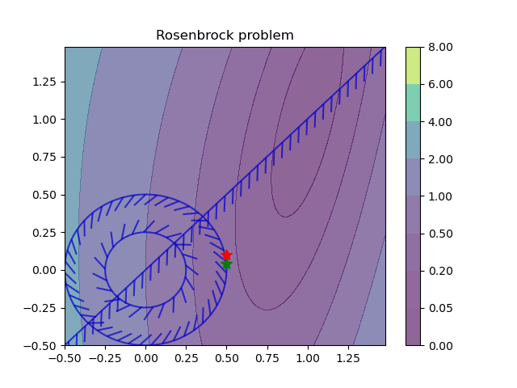
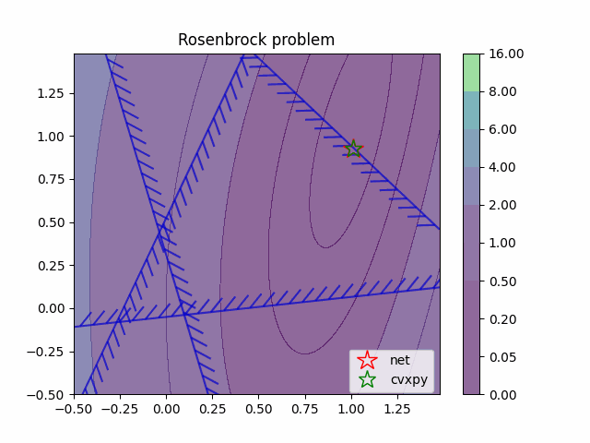
Learning to Optimize with Constraints
Training neural networks as optimization solutions
Application: solving optimal power flow
James Kotary, et al., End-to-End Constrained Optimization Learning: A Survey, IJCAI, 2021

Slide 15
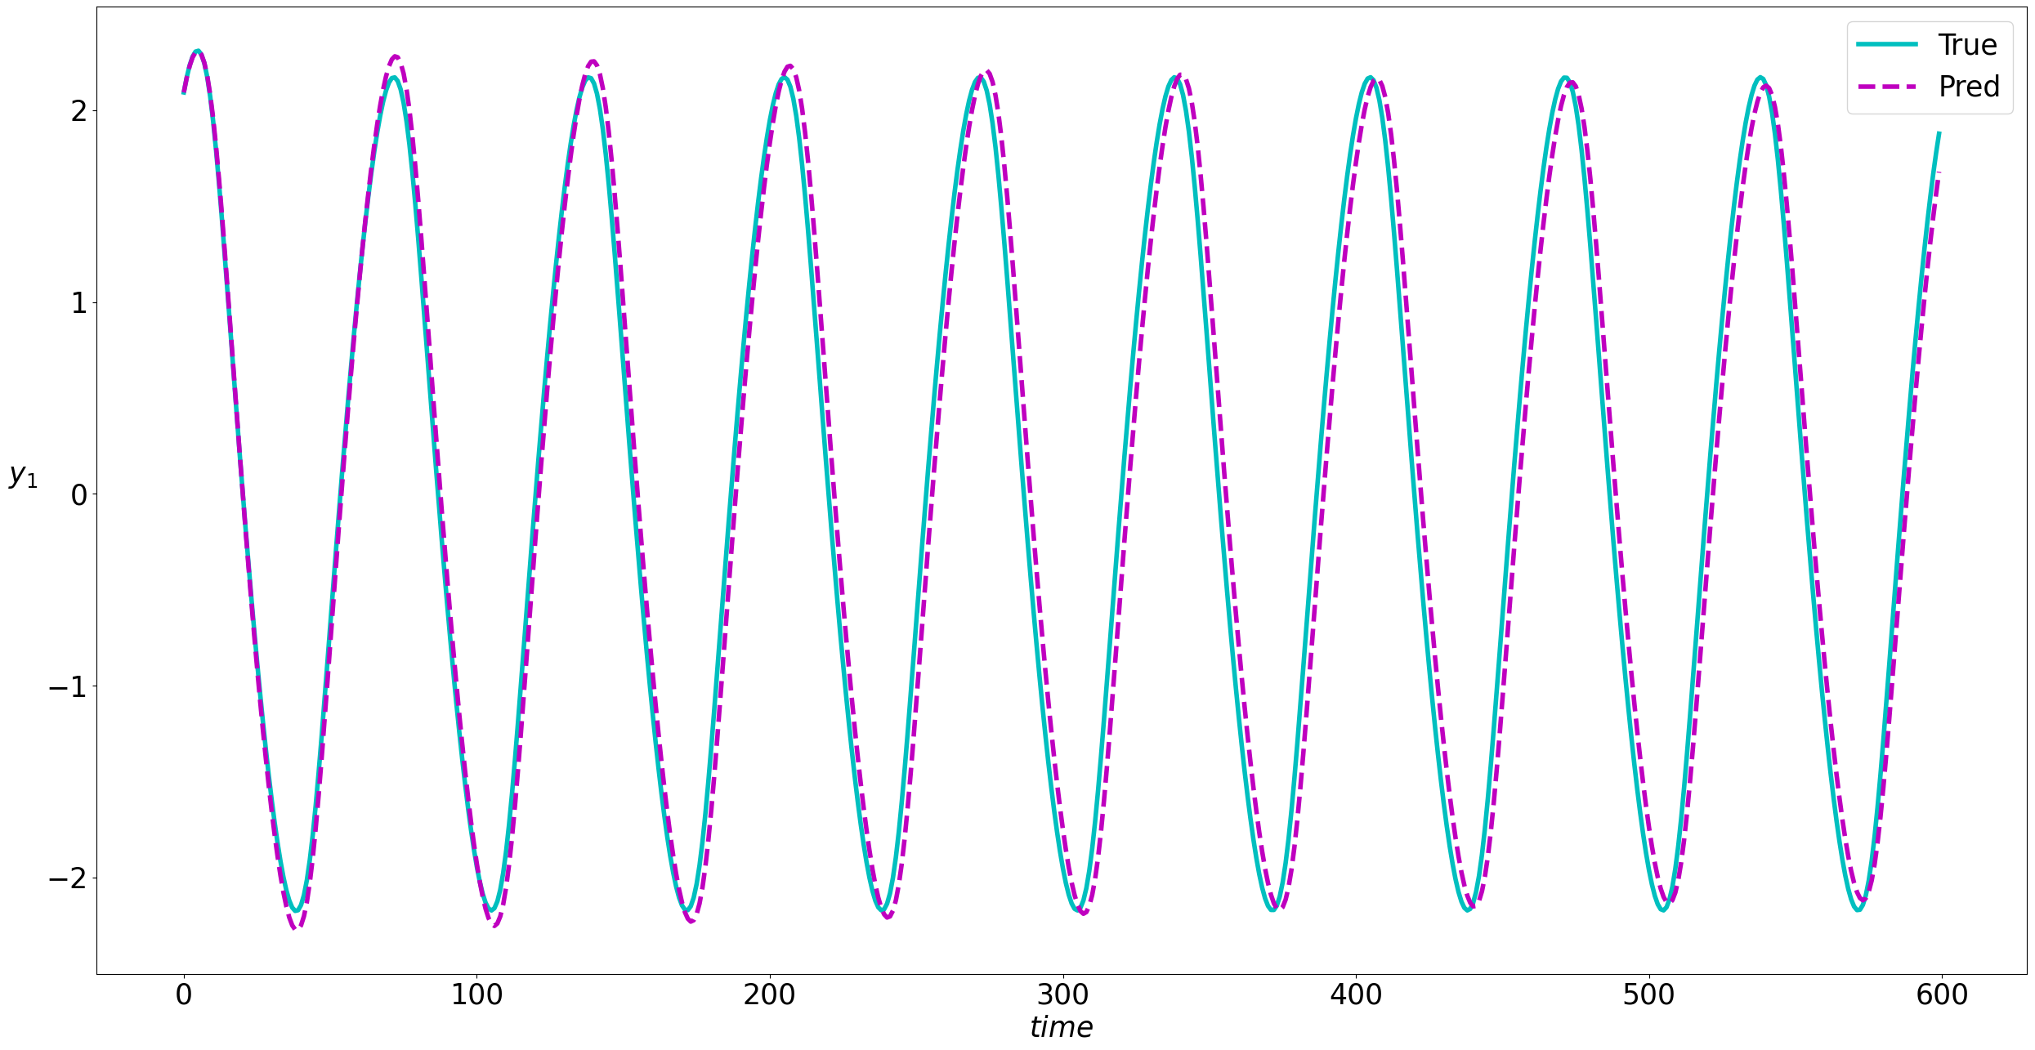
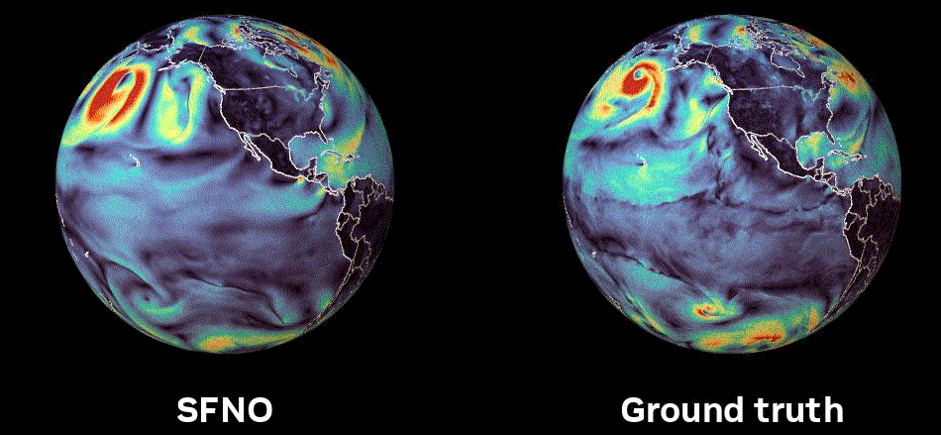
Learning to Model Dynamical Systems
Neural models for nonlinear system identification
Application: climate modeling
R. T. Q. Chen, et al., Neural ordinary differential equations. NeurIPS, 2018
C. Rackauckas, et al., Universal Differential Equations for Scientific Machine Learning, 2021
Image: NVIDIA FourCastNet

Slide 16
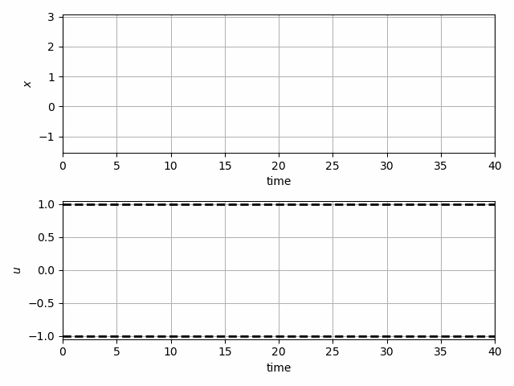
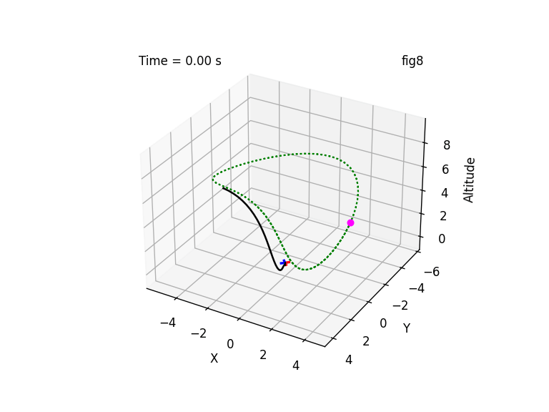
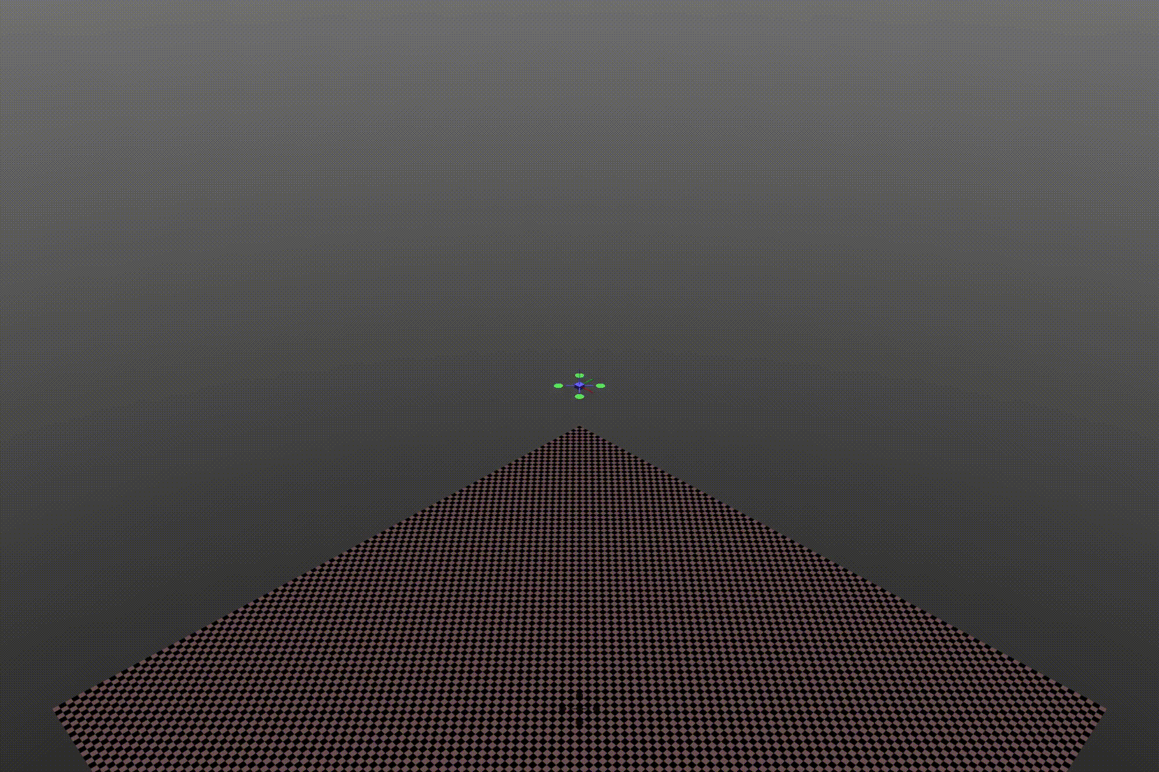
Learning to Control with Differentiable System Models
Trajectory optimization for dynamical systems
Application: autonomous systems
J. Drgoňa, A. Tuor and D. Vrabie, "Learning Constrained Parametric Differentiable Predictive Control Policies With Guarantees," in IEEE Transactions on Systems, Man, and Cybernetics: Systems, 2024

Slide 17

NeuroMANCER Scientific Machine Learning Library
Open-source library in PyTorch
Physics-informed Neural Networks
Learning to optimize
Neural differential equations
Learning to control
github.com/pnnl/neuromancer

Slide 18
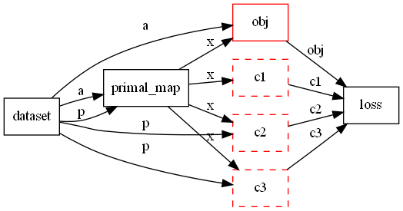
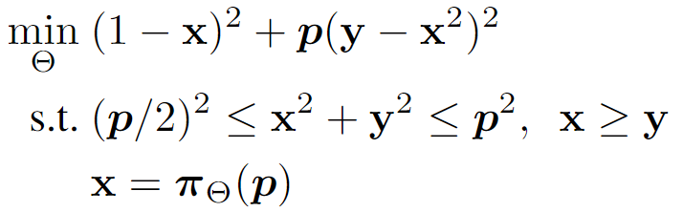
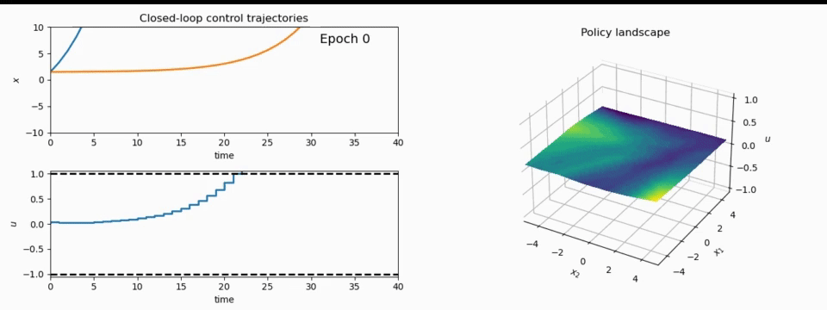
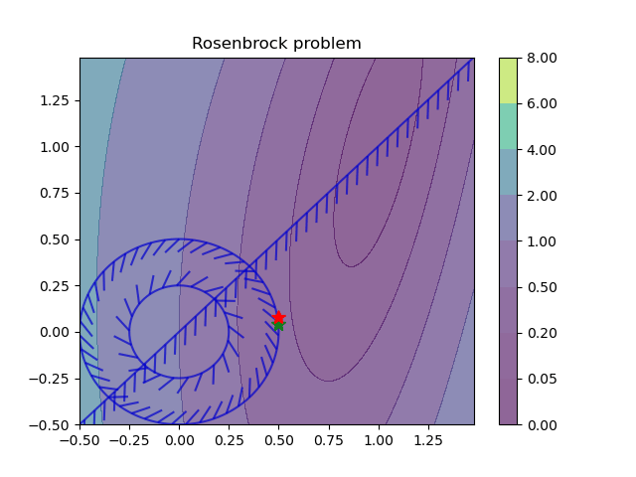
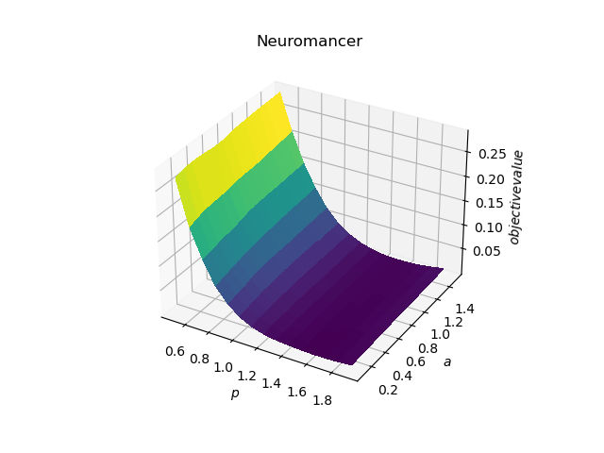
NeuroMANCER Scientific Machine Learning Library
1. Mathematical formulation
3. Problem graph
map
2. Python code interface
4. Results
import neuromancer as nm
p = nm.variable(‘p’)
x = nm.variable(‘x’)
y = nm.variable('y’)
obj = ((1-x)**2 + p*(y-x**2)**2).minimize(weight=1.0, name='obj’) c1 = (p/2)**2 <= x**2 + y**2
c2 = x**2 + y**2 <= p**2
c3 = x >= y net = nm.MLP(insize=2, outsize=2, hsizes=[80]*4) map = nm.Node(net, input_keys=['p’], output_keys=[‘x’,‘y’])
loss = nm.PenaltyLoss([obj], [c1, c2, c3]) problem = nm.Problem([map], loss)
optimizer = torch.optim.AdamW(problem.parameters()) trainer = nm.Trainer(problem,data,optimizer)
best_model = trainer.train()

Slide 19


Learning to Control Building Energy System
Benefits of Scientific Machine Learning-based Digital Twins
Modeling and optimal control design is roughly 10-times faster and requires less expertise.
Real-time decisions are made orders of magnitude faster than traditional model-based approaches.
J. Drgona, et al., Physics-constrained deep learning of multi-zone building thermal dynamics, Energy and Buildings, 2021
J. Drgona, et al., Deep Learning Explicit Differentiable Predictive Control Laws for Buildings, IFAC NMPC 2021

Slide 20
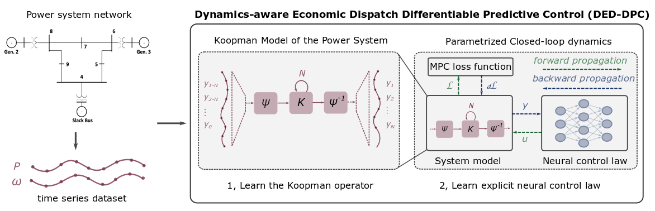
Learning to Control Power System
Benefits of Scientific Machine Learning-based Digital Twins
Fast prototyping by re-using code template from building control project.
Real-time decisions are made orders of magnitude faster than traditional model-based approaches.
Ethan King, et al., Koopman-based Differentiable Predictive Control for the Dynamics-Aware Economic Dispatch Problem, American Control Conference 2022

Slide 21


New Frontiers in Engineering of Digital Twins
Differentiable Programming enables gradient-based Scientific Machine Learning.
Scientific Machine Learning accelerates the design of digital twins by combining physics with data.
Digital twins enable fast real-time optimal decision-making and control.
Open-source software facilitates technology adoption and research reproducibility.
jan.drgona@pnnl.gov
drgona.github.io

Slide 22














Acknowledgements
Aaron Tuor
James Koch
Madelyn Shapiro
Bruno Jacob
Rahul Birmiwal
Ethan King
Sonja Glavaski
Sayak Mukherjee
Wenceslao Shaw Cortez
Soumya Vasisht
Shrirang Abhyankar
Mahantesh Halappanavar
Panos Stinis
Draguna Vrabie

